Slide 1
Miscellaneous Audit
Michael lewis, Miscellaneous audit manager

Slide 2
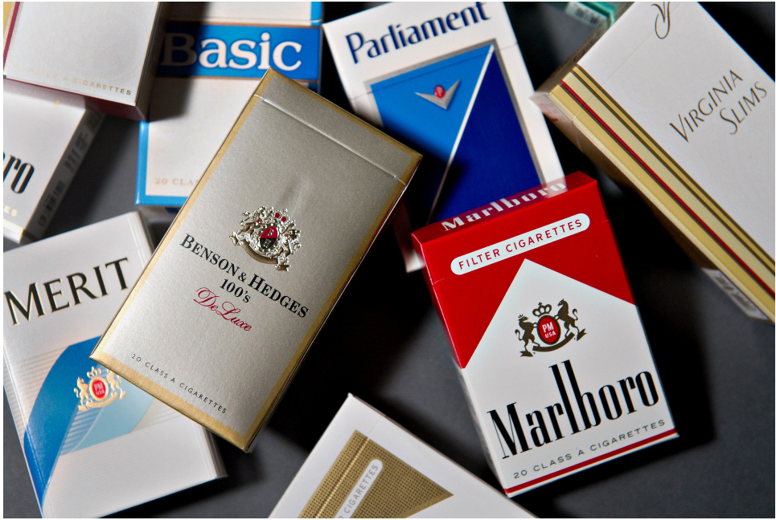
DEFINITIONS
Cigarettes:
Any roll for smoking made wholly or in part of tobacco irrespective of size, shape and
The wrapper or cover is made of paper or any material other than tobacco
Weighing 3 pounds per thousand or less

Slide 3
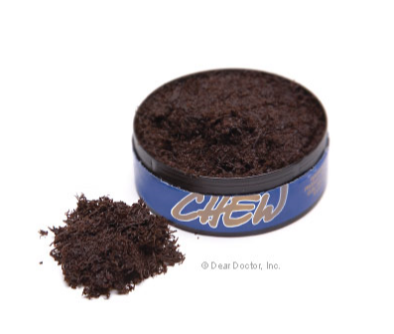
DEFINITIONS
Other Tobacco Products (OTP):
Little Cigarillos
Snuff
Snus
Chew
Cigars
Wraps
RYO (Roll Your Own) Cigarette Tobacco

Slide 4
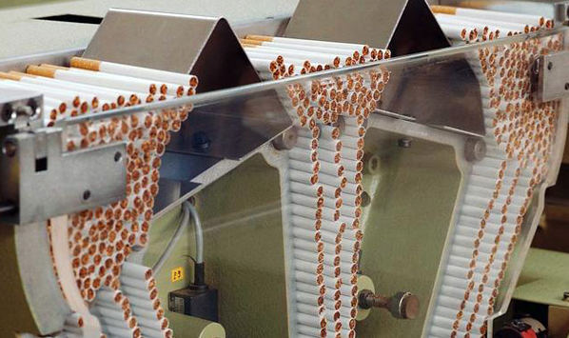
DEFINITIONS
Manufacturer
Distributor
Retailer

Slide 5
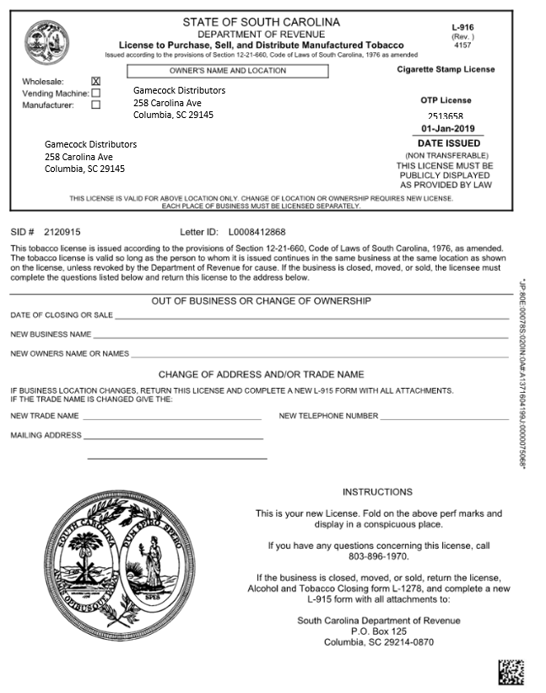
LICENSES
Cigarette and OTP
Distributors
No fee
No expiration
Separate license per location

Slide 6
MASTER SETTLEMENT AGREEMENT
History:
Mississippi sued the major tobacco companies in 1994
Marketing to youth
Fraudulent representations regarding health consequences
Manipulating nicotine content to increase addiction

Slide 7
MASTER SETTLEMENT AGREEMENT
Signed November 23, 1998
Members of MSA
46 states and District of Columbia
5 US Territories
Originally the 4 largest tobacco manufacturers
Presently 40+ other manufacturers

Slide 8
MASTER SETTLEMENT AGREEMENT
South Carolina receives approximately $70 - $90 million annually from the MSA.
The 2017 MSA payment (before distribution between the states) was approximately $6 billion
Attorney General’s (AG) responsibility
Due diligence

Slide 9
NON PARTICIPATING MANUFACTURER (NPM)
Cigarette Manufacturer that is not part of the MSA
Licensed distributors must report these sales on monthly cigarette report
Attorney General collects escrow from manufacturer on sales into SC

Slide 10
TOBACCO DIRECTORY
List of tobacco products that in compliance with the SC Escrow Fund Act
Issued by the Attorney General’s Office
Updated on the 1st and 15th of each month
Found on the Attorney General’s website

Slide 11
DELISTED PRODUCTS
Tobacco brands not in compliance with the SC Tobacco Escrow Fund Act
Cigarettes and OTP no longer allowed to be sold in South Carolina

Slide 12
OTP TAX RATE
5% of Manufacturers cost
1st person that imports, receives or acquires the OTP product is responsible for the excise tax

Slide 13
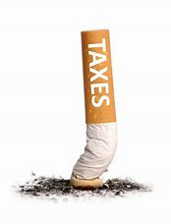
CIGARETTE TAX RATE
$.0285 per stick
$0.57 per pack of 20
$0.71 per pack of 25
1st person that imports, receives or acquires the cigarette is responsible for the excise tax

Slide 14
CIGARETTE TAX STAMPS
January 1, 2019 – SC became the 48th state to require cigarette packs to be stamped
Benefits
Reduces illicit trade
Improve supply-chain monitoring
Enforcement

Slide 15
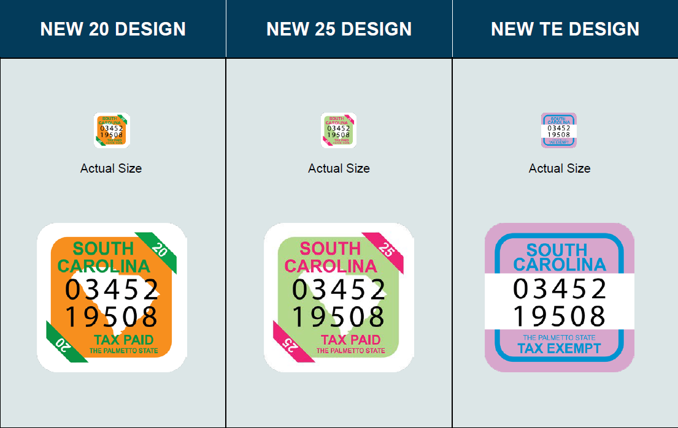
SOUTH CAROLINA FUSON® STAMP

Slide 16
INSPECTIONS
Distributors:
Inventory count sampling
Examination of inventory
Operations (stamping)
Retail Locations:
Verify SC excise tax paid/Stamp Issues
Sale of “Loosies”

Slide 17
STAMP ISSUES
Half Stamp
Corner Stamp
Out of State Stamp
No Stamp
Stamped Cartons

Slide 18
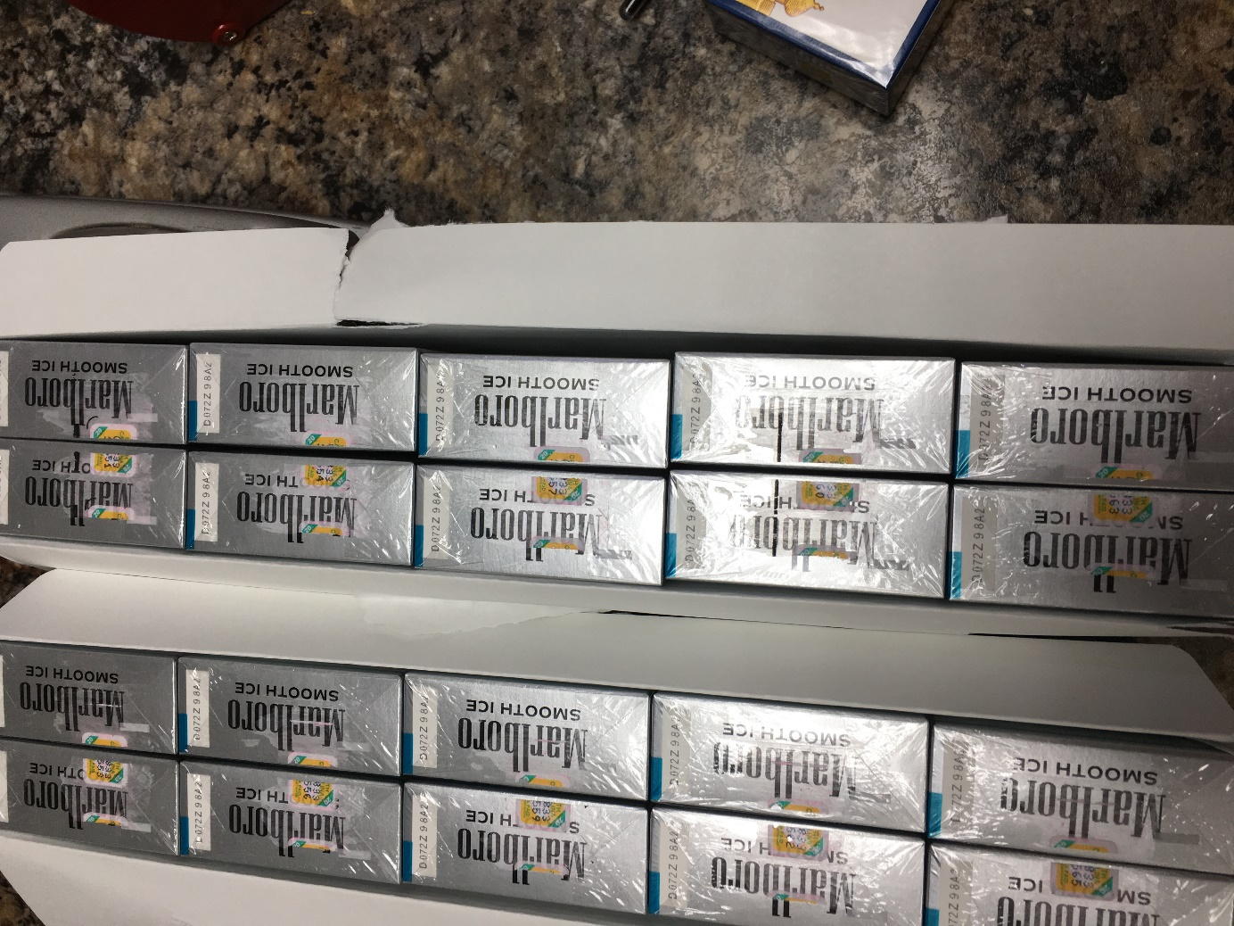
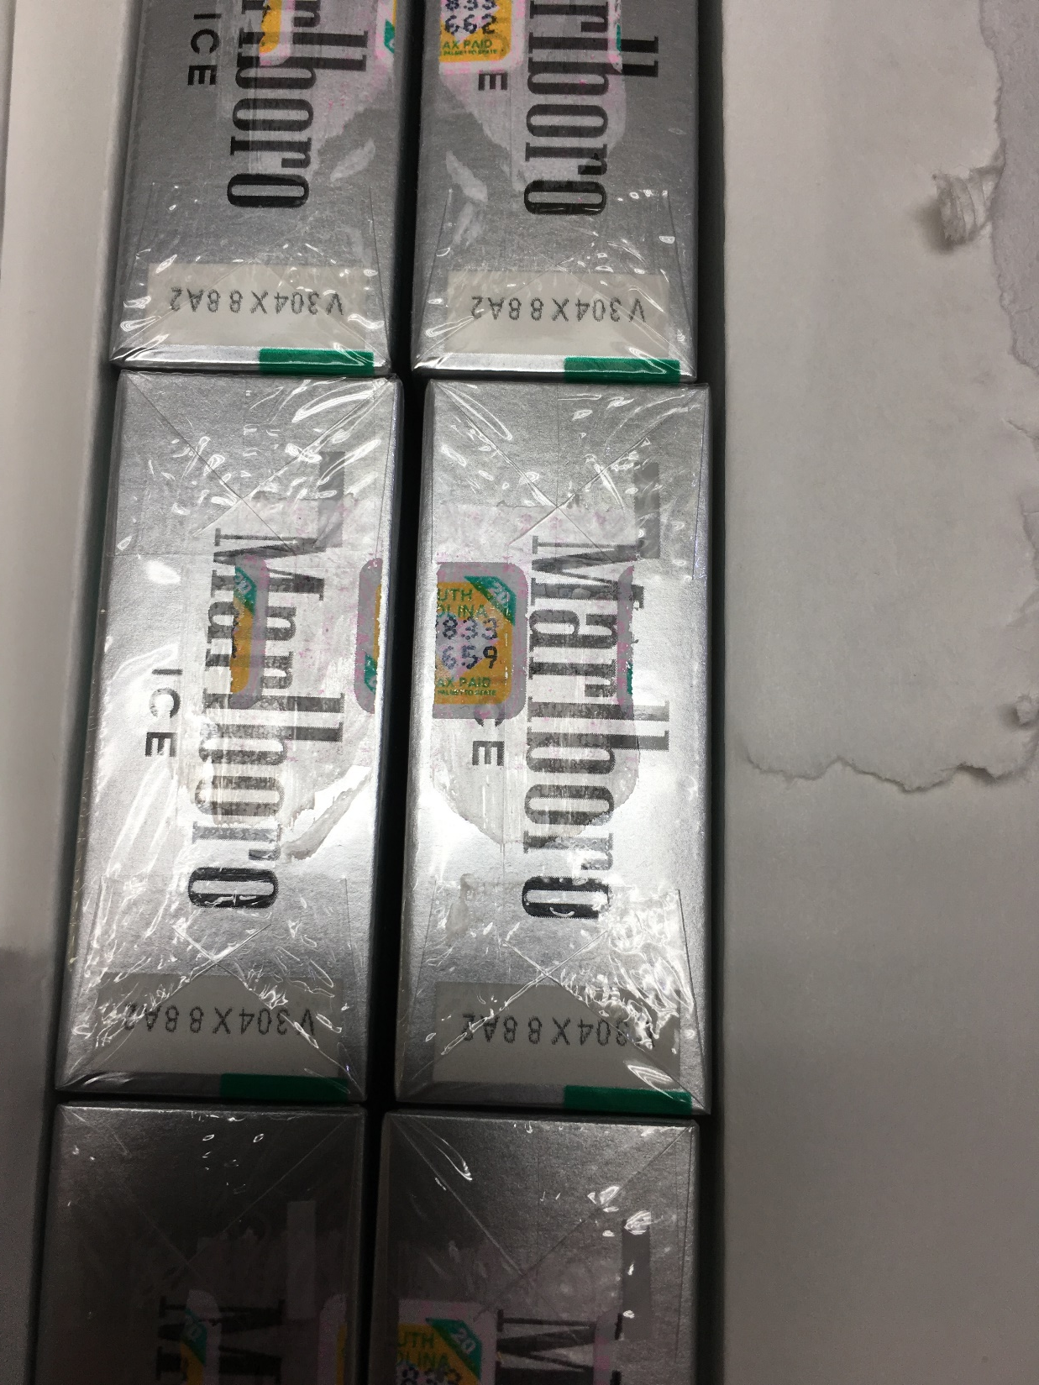
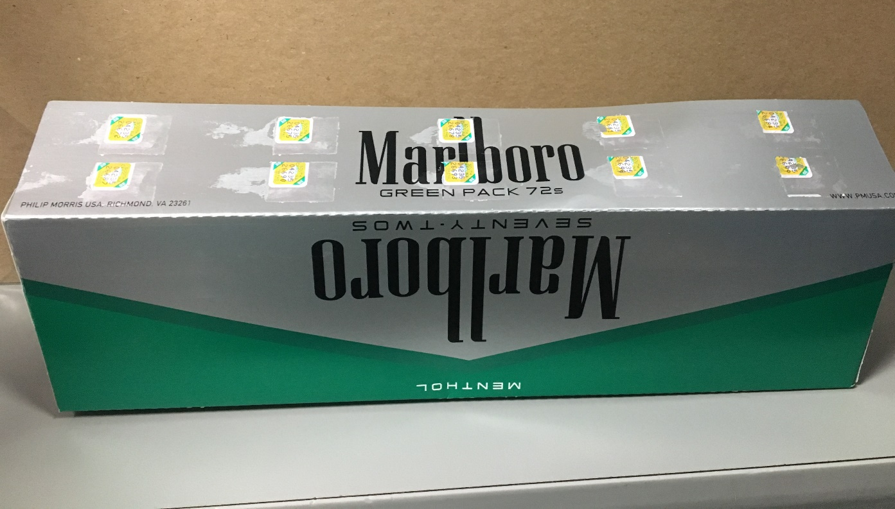

Slide 19
VIOLATIONS
Loosies
Delisted Products
No SC Tax Stamp / Out of state tax stamps
Non Tax Paid
FSC

Slide 20
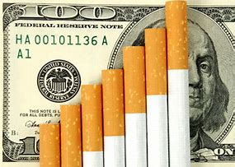
VIOLATIONS
Sale of “Loosies”
Unstamped cigarettes
Insufficiently stamped cigarettes
Incorrect stamp applied
Counterfeit products
Results:
Product seized
$50 - $500 violation per pack

Slide 21
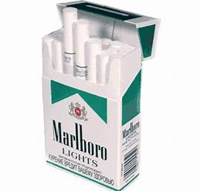
VIOLATIONS
Non Monetary
FSC violation- not listed on SC Fire marshals Fire Standards Compliant brand listing as a Fire Safe Cigarette. 23-51-60
Cigarettes not on SC Tobacco Directory 11-48-30(c)
Monetary
Packages marked for sale outside of SC marked Tax Exempt, For Export Only etc. 12-21-2870, 12-54-43(H)
Unstamped, Insufficiently stamped, Loosies 12-21-2870, 12-54-43(H)

Slide 22
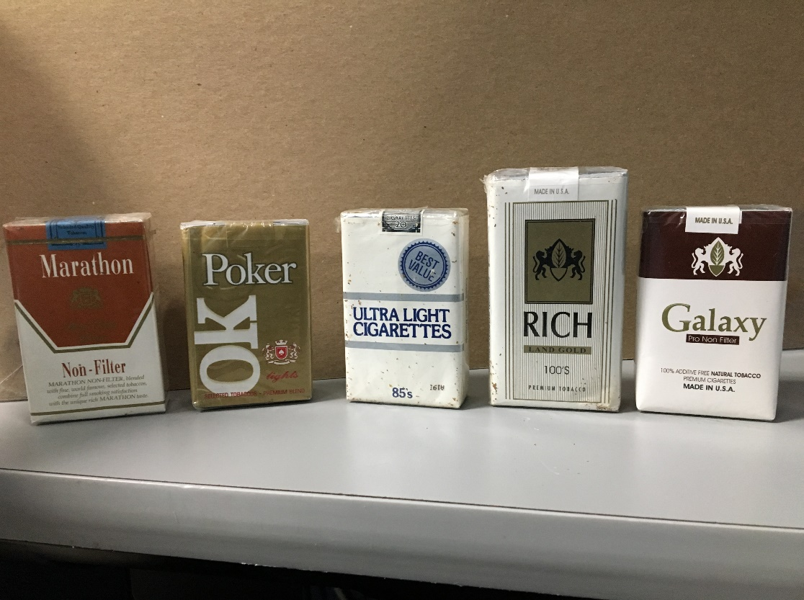
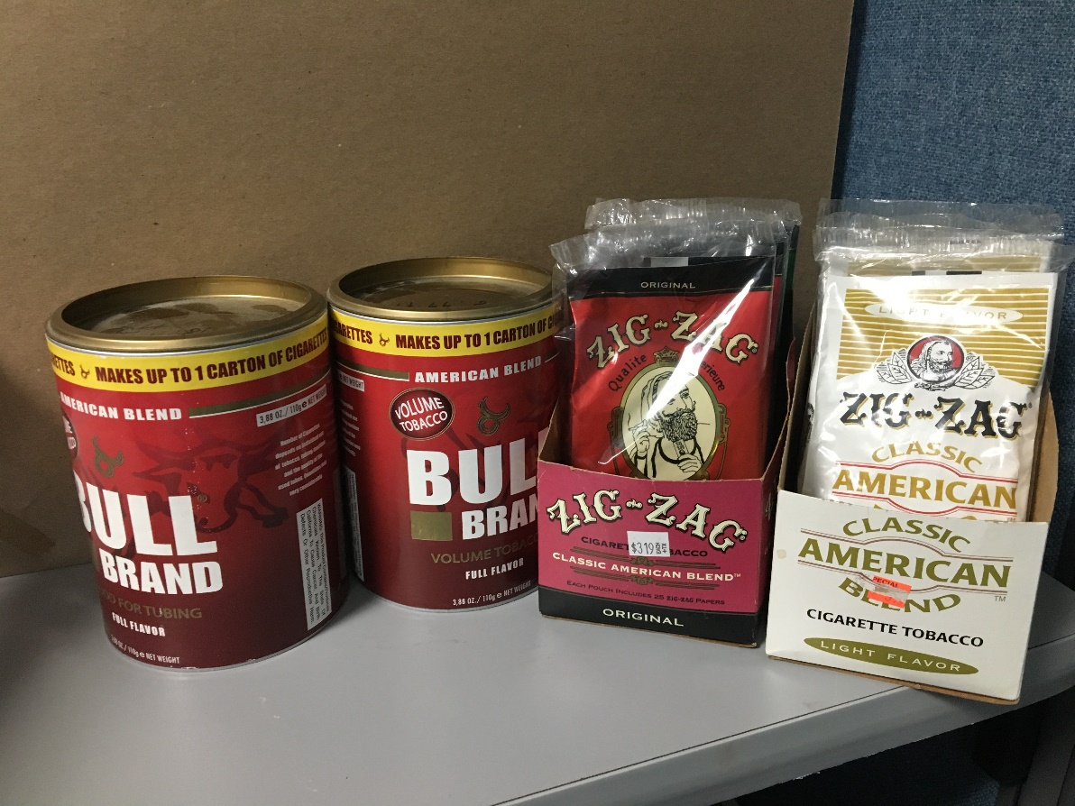
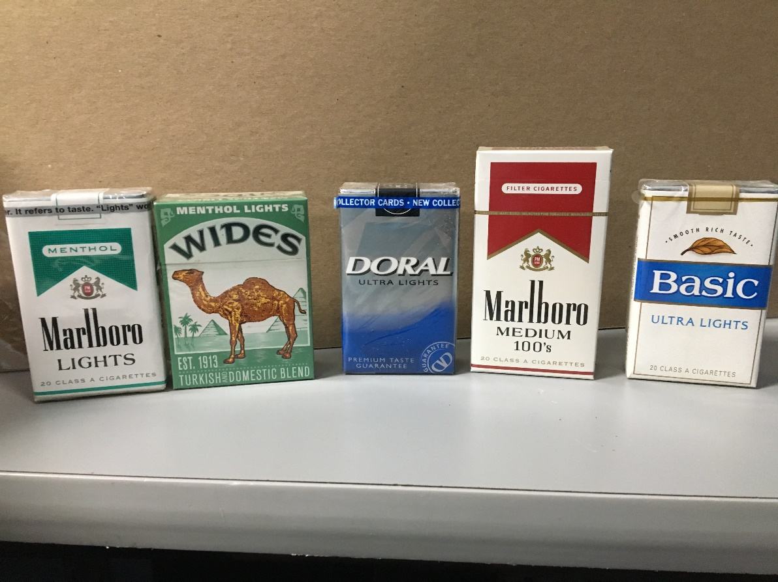

Slide 23
DESTRUCTION OF PRODUCT
Destruction of contraband
FSC and Delisted product violations sent to the SC Attorney General office.
Product is destroyed after Waiver of Adjudication is received from Attorney General office.
Non-Tax Paid and Loosie violation
Product is destroyed after violation is agreed upon, paid, or met its appeal period of 90 days.
South Carolina does not auction off confiscated product. All confiscated products are incinerated.

Slide 24
ISSUES ENCOUNTERED
Uncooperative owners or clerks
SECTION 12-21-3080. Penalty for interference with enforcement or refusal to allow inspection.
Unstamped Cigarettes – Grace Period
Since stamps are new in SC we still have a large inventory of cigarettes in retail businesses that are not stamped.
Grace Period Ends October 1, 2019

Slide 25
AUDITS
Ensure tobacco distributors are paying the appropriate tobacco excise tax.
Verify that tobacco distributors have reported the correct sales of NPM products in order for the Attorney General to collect the escrow from the manufacturers.

Slide 26
RELATIONSHIPS
Alcohol and Tobacco Tax and Trade Bureau
South Carolina Law Enforcement Division
Other Federal and State agencies

Slide 27
THINGS YOU MAY NOT KNOW
Loosie-
SECTION 16-17-505. Cigarette packages violating certain federal laws; illegal sale or distribution; penalties; seizure.
(2) It is unlawful to sell, hold for sale, or distribute a package of cigarettes if:
(a) the package differs in any respect with the requirements of the Federal Cigarette Labeling and Advertising Act, 15 U.S.C. 1331, for the placement of labels, warnings, or any other information upon a package of cigarettes that is to be sold within the United States;

Slide 28
THINGS YOU MAY NOT KNOW
Cigarettes Not Intended for Sale in The United States-
SECTION 16-17-505. Cigarette packages violating certain federal laws; illegal sale or distribution; penalties; seizure.
(2) It is unlawful to sell, hold for sale, or distribute a package of cigarettes if:
(b) the package is labeled "For Export Only", "U.S. Tax Exempt", "For Use Outside U.S.", or similar wording indicating that the manufacturer did not intend that the product be sold in the United States;

Slide 29
THINGS YOU MAY NOT KNOW
Penalty for Looises and Cigarettes Not Intended for Sale in The United States-
SECTION 16-17-505
(3) A person who knowingly sells, holds for sale, or distributes cigarette packages in violation of subsection (2) is guilty of a misdemeanor and, upon conviction, shall be imprisoned for not more than three years or fined not more than one thousand dollars, or both.
(4) In addition to the other penalties provided by law, law enforcement may seize and destroy or sell to the manufacturer, for export only, any packages described in subsection (2).

Slide 30
THINGS YOU MAY NOT KNOW
E-Cigarettes Not Intended for Sale in The United States-H.3420(Signed by the Governor on April 26, 2019
Section 16-17-506.
(2) It is unlawful to sell, hold for sale, or distribute a container of e-liquid unless:
(a) the container satisfies the requirements of 21 C.F.R. 1143.3, if applicable, for the placement of labels, warnings, or any other information upon a package of e-liquid that is to be sold within the United States;
(b) the container complies with child-resistant effectiveness standards under 16 C.F.R. 1700.15(b)(1) when tested in accordance with the requirements of 16 C.F.R. 1700.20; and
(c) the container complies with federal trademark or copyright laws.

Slide 31
THINGS YOU MAY NOT KNOW
Penalty for E-Cigarettes Not Intended for Sale in The United States-H.3420(Signed by the Governor on April 26, 2019
Section 16-17-506.
(3) A person who knowingly sells, holds for sale, or distributes e-liquid containers in violation of subsection (2) is guilty of a misdemeanor and, upon conviction, shall be imprisoned for not more than three years or fined not more than one thousand dollars, or both.
(4) In addition to the other penalties provided by law, law enforcement may seize and destroy or sell to the manufacturer, for export only, any containers in violation of this section."

Slide 32
JUUL PRODUCT NOT INTENDED FOR SALE IN THE UNITED STATES

Slide 33
JUUL PRODUCT NOT INTENDED FOR SALE IN THE UNITED STATES

Slide 34
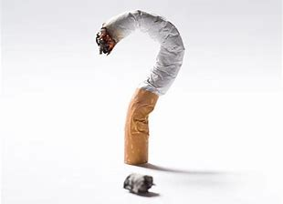

Slide 35
Miscellaneous Audit Section
Michael Lewis
Office| 803-898-5771
Cell | 803-605-0904
Michael.Lewis@dor.sc.gov
Matthew Group
Office| 843-953-8374
Cell | 843-494-3116
Matthew.Group@dor.sc.gov
dor.sc.gov /dor.sc.gov @scdor

Slide 36
Miscellaneous Audit Section
Michael Gilstrap
Office| 864-552-4919
Cell | 803-898-0135
Michael.Gilstrap@dor.sc.gov
Josh Cruea
Office| 803-898-5693
Cell | 803-509-3397
Josh.Cruea@dor.sc.gov
Tyrone Donaldson
Office| 803-898-5192
Cell | 803-722-9349
Tyrone.Donaldson@dor.sc.gov
dor.sc.gov /dor.sc.gov @scdor

